Slide 1
The Rady School of Management
MGT 103
Lecture #14
Retailing & Wholesaling
Marketing Communications
March 2, 2020

Slide 2
Group Work…..
Assemble in your Marketing Plan work groups
Review key marketing channels used by HBO to promote Game of Thrones
What additional promotions would you design using the existing channels
What additional marketing channels would you use to promote GOT. Why? How would you measure ROI?
15 minutes to complete

Slide 3
LEARNING OBJECTIVES (LO)
Identify retailers in terms of the utilities they provide.
Explain the alternative ways to classify retail outlets.
Describe the many methods of “non-store” retailing.
Classify retailers in terms of the retail positioning matrix, and specify retailing mix actions.

Slide 4
LEARNING OBJECTIVES (LO)
Explain changes in retailing with the wheel of retailing and the retail life-cycle concepts.
Describe the types of firms that perform wholesaling activities and their functions.

Slide 5
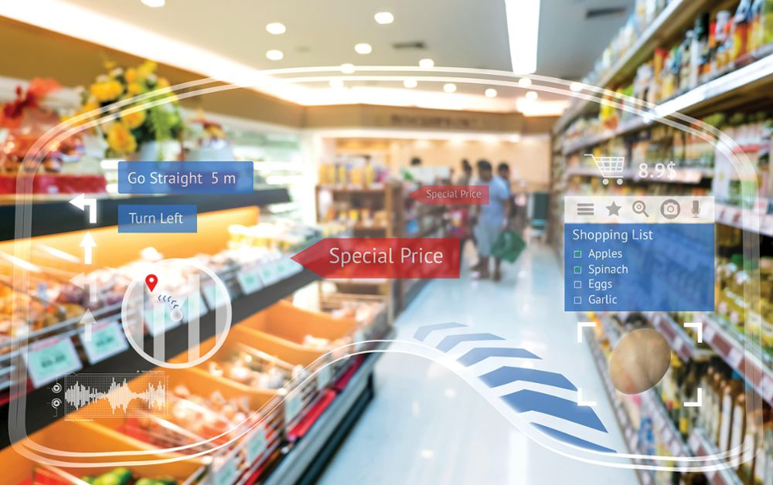
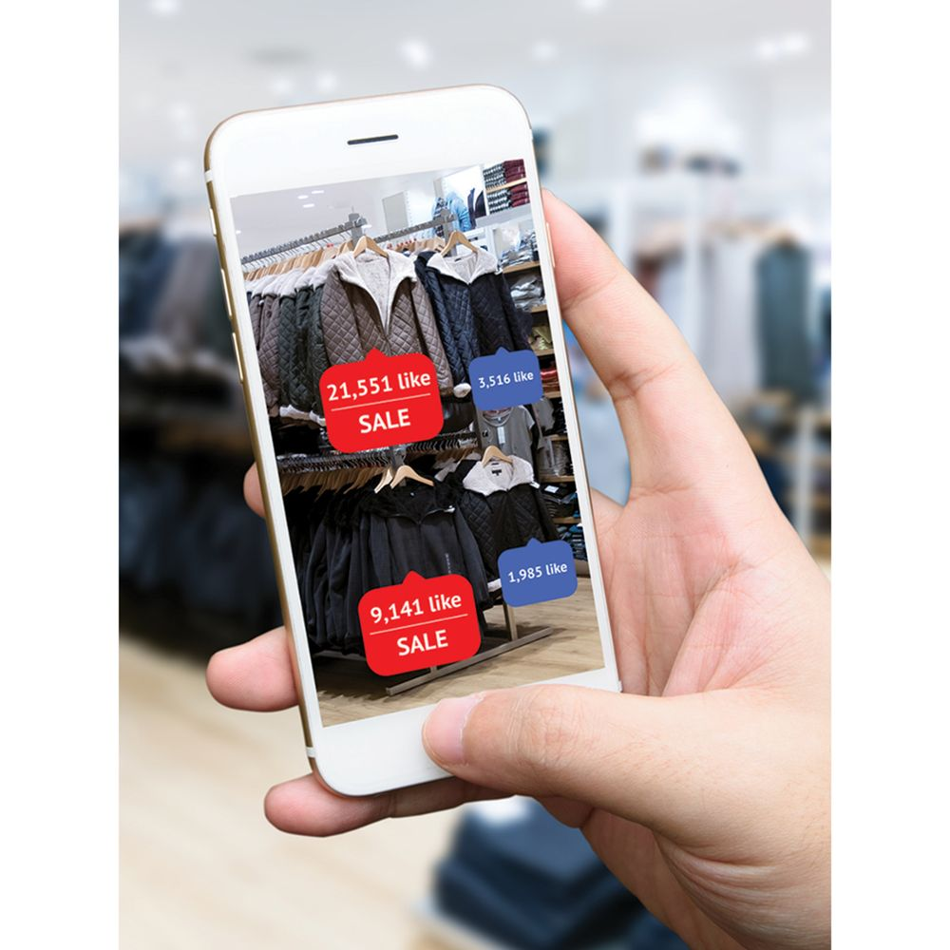
SMART STORES ARE CHANGING THE CUSTOMER JOURNEY!
Technology and Retailing – The Smart Store:
Biometric Scanners
3-D Modeling Tools
Wearable Technology
Shopping Apps
Pay via Smartphones and Watches
Top: ©Jiraroj Praditcharoenkul Alamy Stock Photo; Bottom: ©Zapp2Photo/Shutterstock

Slide 6
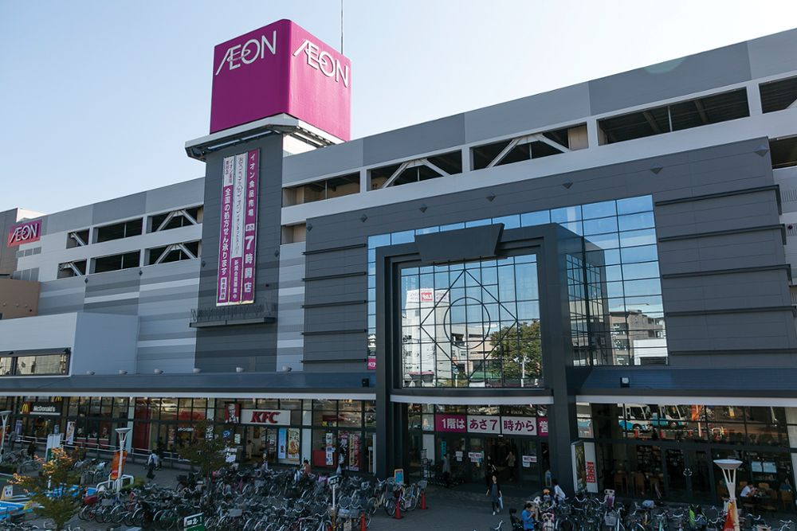
THE VALUE OF RETAILING
Retailing
Consumer Utilities Offered by Retailing
Place
Possession
Form
Time
The Global Economic Impact of Retailing:
5 of 40 Largest Businesses in the U.S. are Retailers
©Rodrigo Reyes Marin/AFLO/Newscom

Slide 7
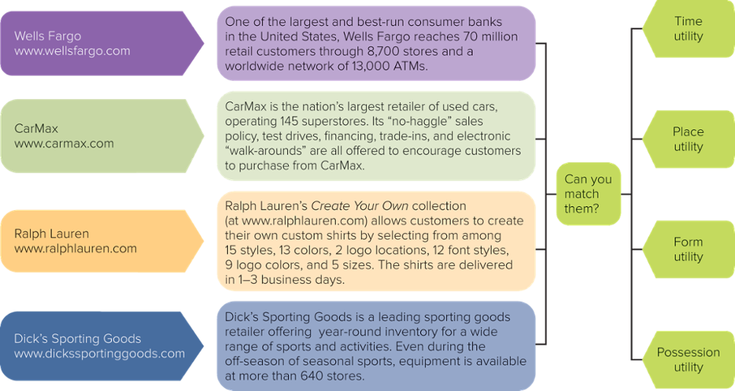
FIGURE 16-1 Which retailer best provides which utilities? Copyright © McGraw-Hill Education. Permission required for reproduction or display.

Slide 8

MAKING RESPONSIBLE DECISIONS How Green Is Your Retailer? The Rankings are Out!
Nielsen Survey of Consumers in 60 Countries:
55 Percent Are Willing to Pay More for Products with Positive Environmental Impact
Many Retailers Are “Going Green”
Social and Environmental Responsibility
Does it Matter to You?
Newsweek Green Rankings

Slide 9

CLASSIFYING RETAIL OUTLETS FORMS OF OWNERSHIP
Independent Retailer
Accounts for Most of the 3.7 Million Stores in the U.S.
Corporate Chain
Has Multiple Outlets under Common Ownership
Contractual Systems
Independently Owned Stores Work Together to Act as a Chain
©R Heyes Design/Alamy

Slide 10
FIGURE 16-3 The top five franchises in the U.S. vary from convenience stores to business support centers.
Franchise | Type of Business | Total Start-Up Cost | No. of Franchises
7-Eleven Inc. | Convenience Store | $37,000 - $1,635,200 | 59,572
McDonald’s | Hamburgers | $1,003,000 - $2,228,000 | 36,899
Dunkin’ Donuts | Bakery | $228,621 - $1,692,314 | 11,941
The UPS Store | Business Support Center | $159,225 - $434,521 | 4,969
Jimmy John’s Gourmet Sandwiches | Sandwiches | $325,500 - $555,000 | 2,636

Slide 11
CLASSIFYING RETAIL OUTLETS TYPE OF MERCHANDISE LINE (1 of 3)
Breadth of Product Line
General Merchandise Stores
Broad Product Line
Large Department Stores
Scrambled Merchandising
Carries Unrelated Product Lines in a Single Store
Walmart
Video

Slide 12
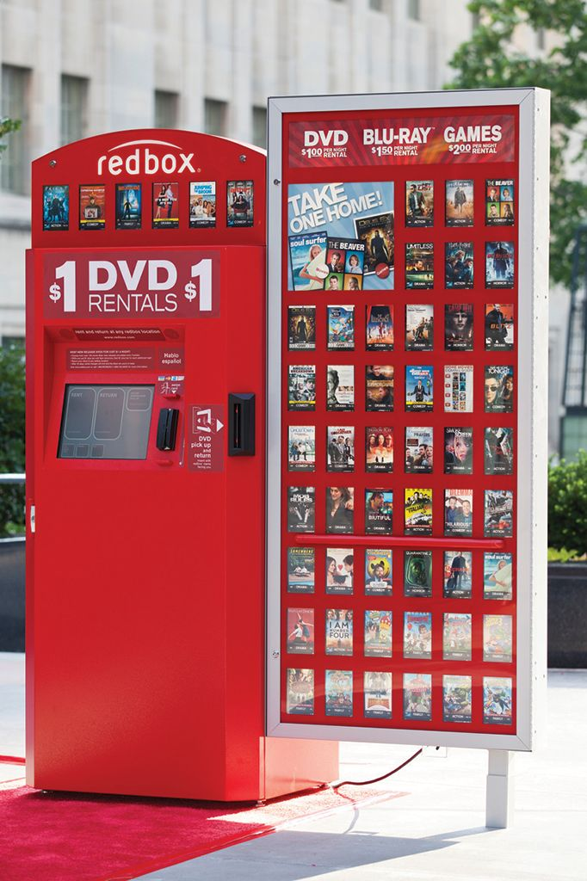
CLASSIFYING RETAIL OUTLETS LEVEL OF SERVICE (2 of 3)
Levels of Service:
Self-Service
Customers Perform Functions
Limited Service
Provide Some Services Only
Full Service
Provide Full Services to Customers
©Ross Dettman/AP Images

Slide 13
CLASSIFYING RETAIL OUTLETS TYPE OF MERCHANDISE LINE (3 of 3)
Hypermarket
Offer Everything Under One Roof
Supercenter
Combines Merchandise Store with Full-Size Grocery Store
Intertype Competition
Occurs Between Dissimilar Types of Retail Outlets

Slide 14
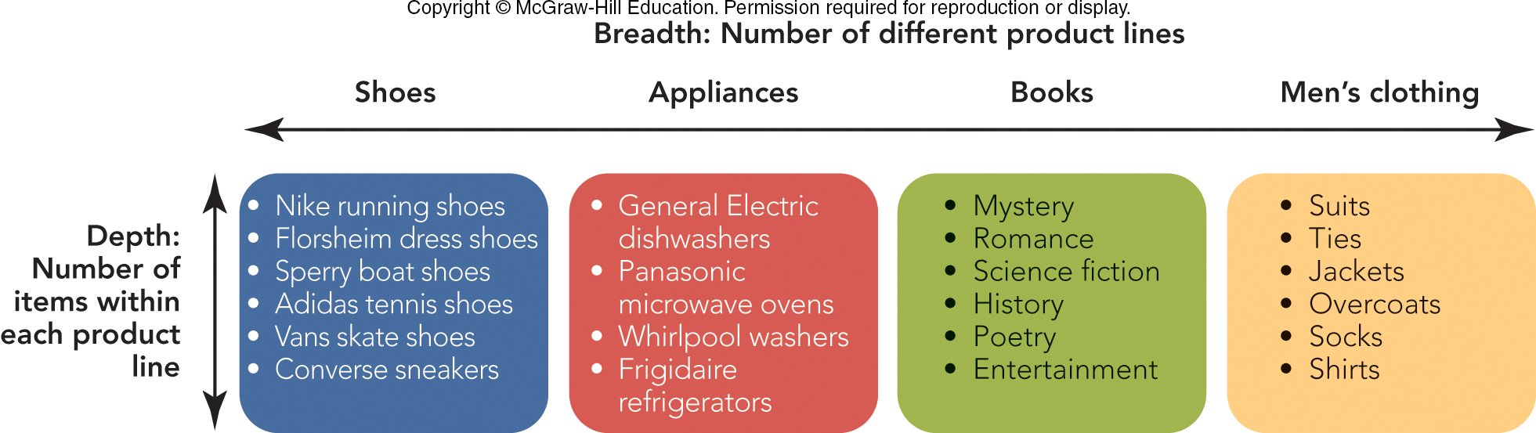
FIGURE 16-4 Stores vary in terms of the breadth and depth of their merchandise lines.

Slide 15
NONSTORE RETAILING
Television Home Shopping:
Consumers Watch a Shopping Channel, then Order
24 Hours, 7 Days a Week, 364 Days a Year
360 Million Homes in U.S., U.K., Germany, Japan, Italy, and China
Online Retailing:
24-Hour Access, Comparison Shop, In-home Privacy

Slide 16
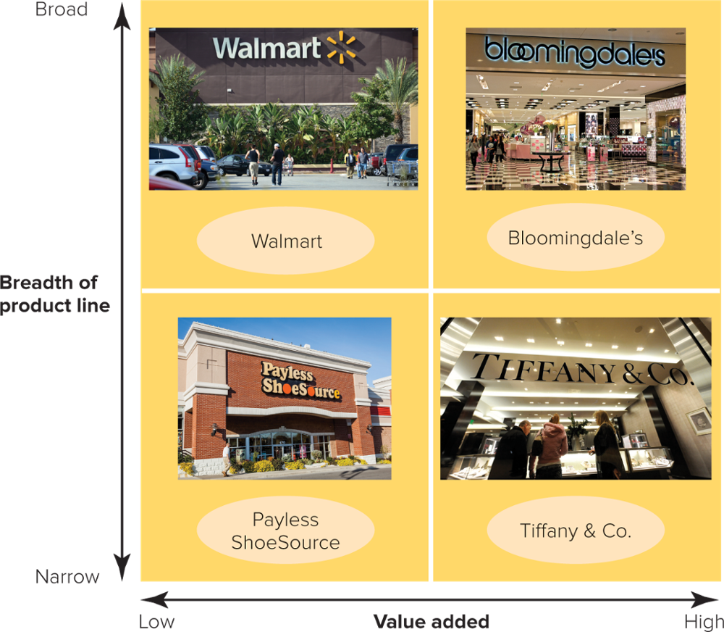
FIGURE 16-8 Positioning strategies for retailers are based on breadth of product line and value added.

Slide 17
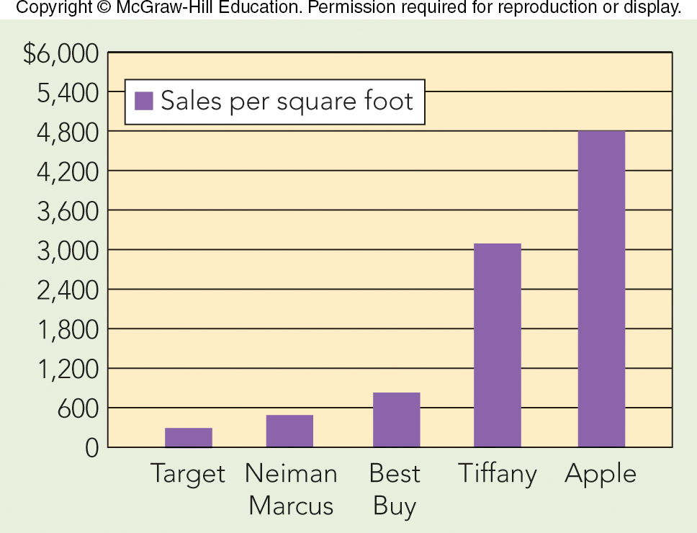
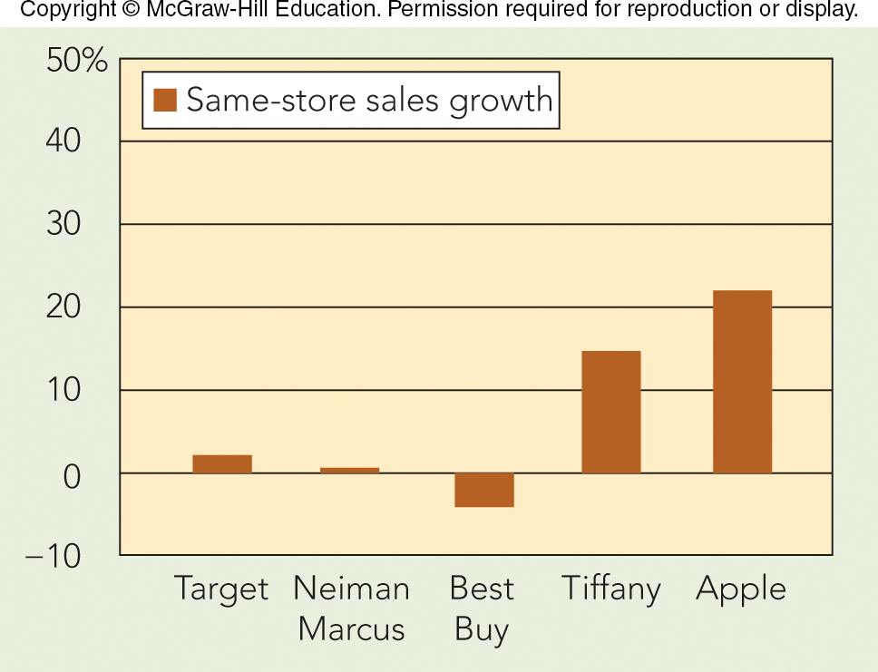
APPLYING MARKETING METRICS Why Apple Stores May Be the Best in the United States!
Sales per Square Foot ($) and Same Store Sales Growth (%)

Slide 18
LEARNING OBJECTIVES (LO) Marketing Communications
Discuss integrated marketing communications and the communication process.
Describe the promotional mix and the uniqueness of each component.

Slide 19
THE COMMUNICATION PROCESS (1 of 3)
Promotional Mix
Combination of 5 Communication Tools
Inform Prospective Buyers
Persuade Them To Try
Remind Them of the Benefits
Integrated Marketing Communications (IMC)
Coordination of Elements Is Important

Slide 20
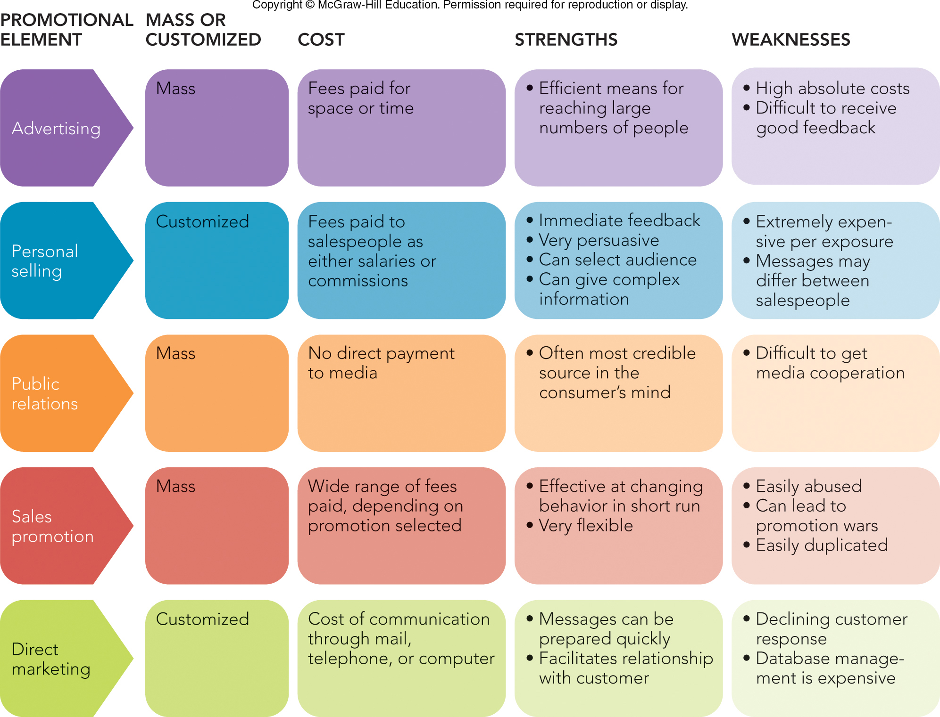
FIGURE 17-2 The five elements of the promotional mix

Slide 21
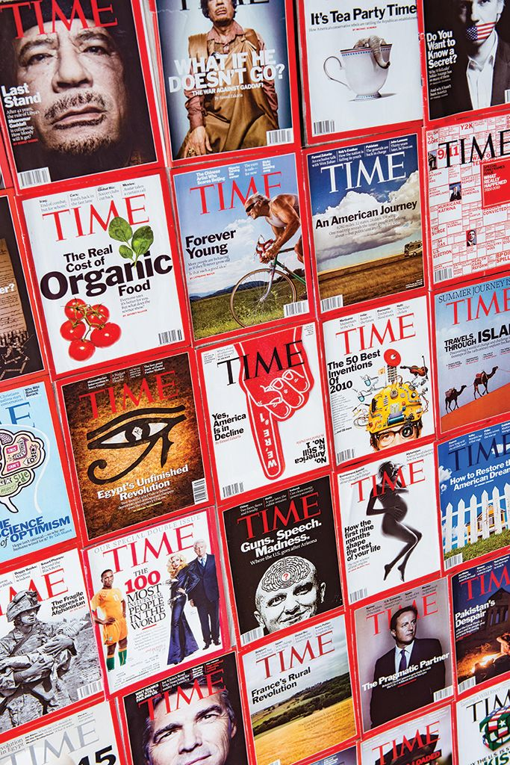
THE PROMOTIONAL ELEMENTS ADVERTISING
Mass Selling versus Customized Interaction
Advertising
Paid Aspect
Nonpersonal
Advantages?
Disadvantages?
©Elnur Amikishiyev/Alamy Stock Photo

Slide 22
THE PROMOTIONAL ELEMENTS PERSONAL SELLING
Personal Selling
Two-Way Flow of Communication Between Buyer and Seller
Beware of Wasted Coverage (Not in Target Market)
Advantages?
Disadvantages?

Slide 23


THE PROMOTIONAL ELEMENTS PUBLIC RELATIONS
Publicity
Public Relations
Influencing Others
Non-Personal, Indirectly Paid Presentation
Advantages?
Disadvantages?

Slide 24

THE PROMOTIONAL ELEMENTS SALES PROMOTION AND DIRECT MARKETING
Sales Promotion
Short-Term Offer to Help Sell
Advantages?
Disadvantages?
Direct Marketing
Direct Communication With Customer
Advantages?
Disadvantages?
©MarsBars/E+/Getty Images
Data and Marketing
Association

Slide 25
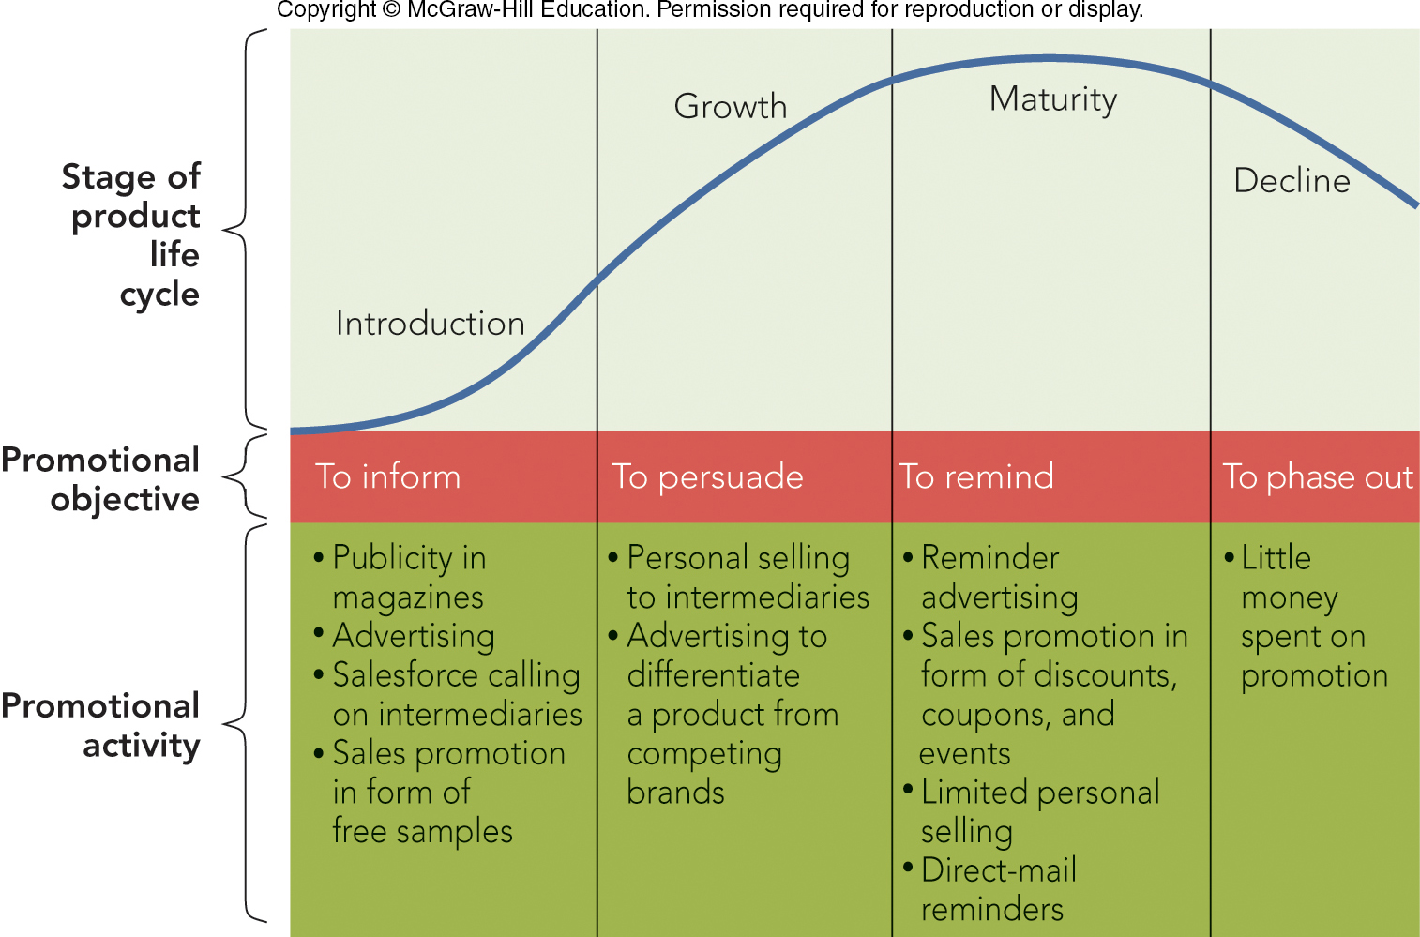
FIGURE 17-3 The product life cycle illustrates how promotional objectives and activities change over the four stages.

Slide 26
IMC—DEVELOPING THE PROMOTIONAL MIX PRODUCT CHARACTERISTICS
Product Characteristics Help Determine the Promotional Mix Elements:
Complexity – Technical Sophistication
Risk – Financial, Social, Physical
Ancillary Services – Degree of Service or Support Required After the Sale

Slide 27
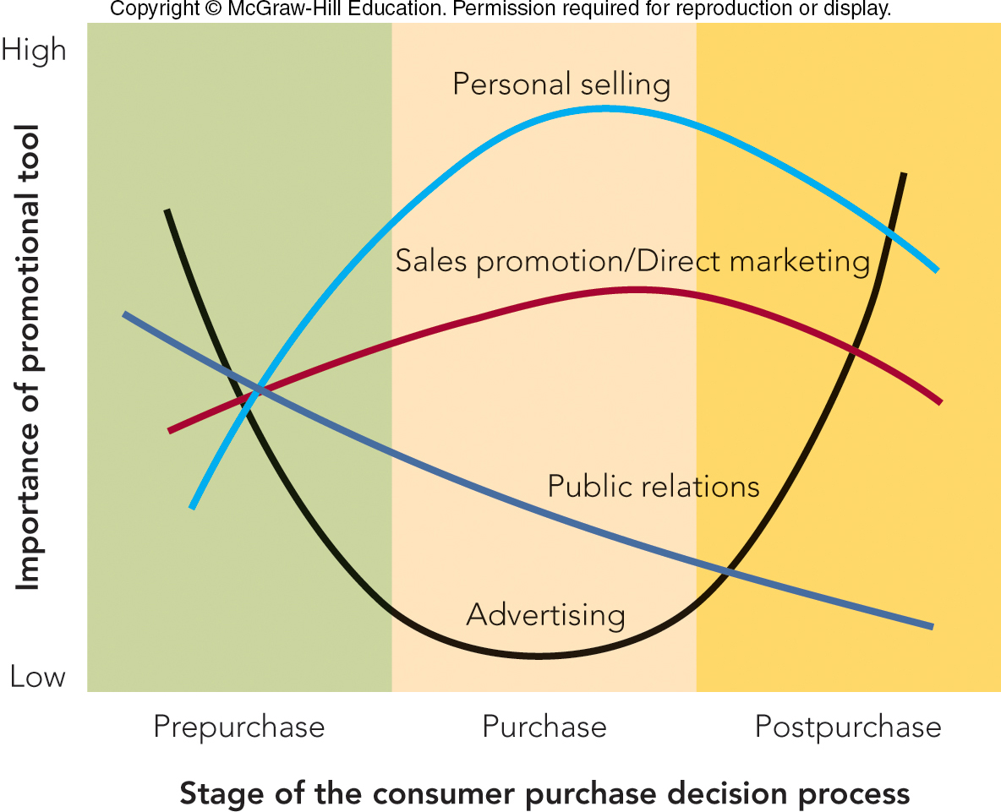
FIGURE 17-4 The importance of promotional elements varies during the stages of the consumer journey.

Slide 28
IMC—DEVELOPING THE PROMOTIONAL MIX Stages of the Buying Decision
Stages of the Buying Decision:
Pre-purchase Stage – Advertising to Inform Customer
Purchase Stage – Personal Selling, Sales Promotion, Social Media
Post-purchase Stage – Personal Contact After the Sale

Slide 29
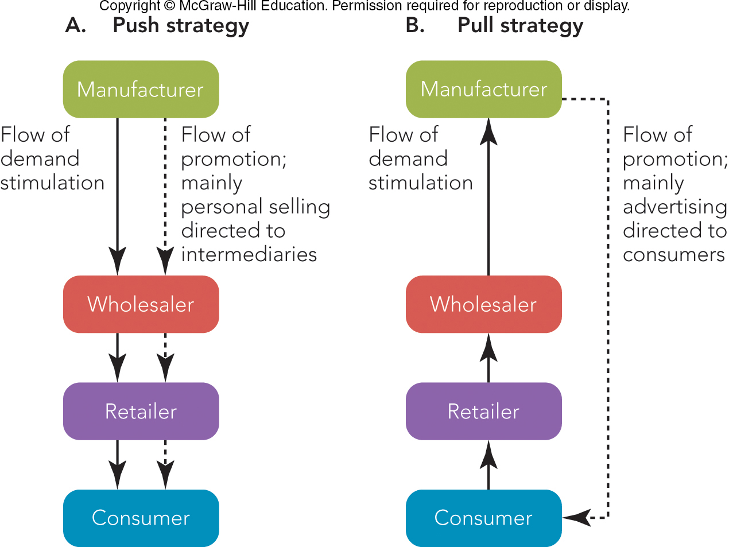
FIGURE 17-5 A comparison of push and pull promotional strategies

Slide 30
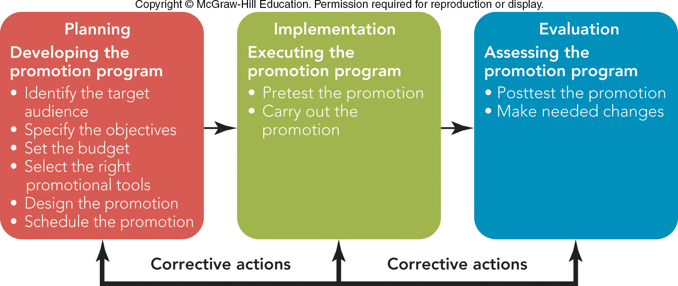
FIGURE 17-5 The promotion decision process includes planning, implementation, and evaluation

Slide 31
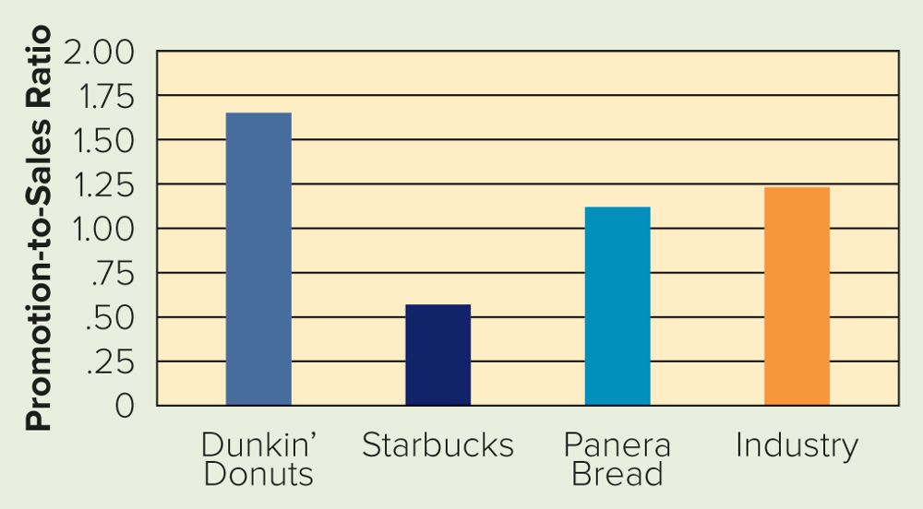

APPLYING MARKETING METRICS How Much Should You Spend on IMC?
Promotion-to-Sales Ratio

Slide 32
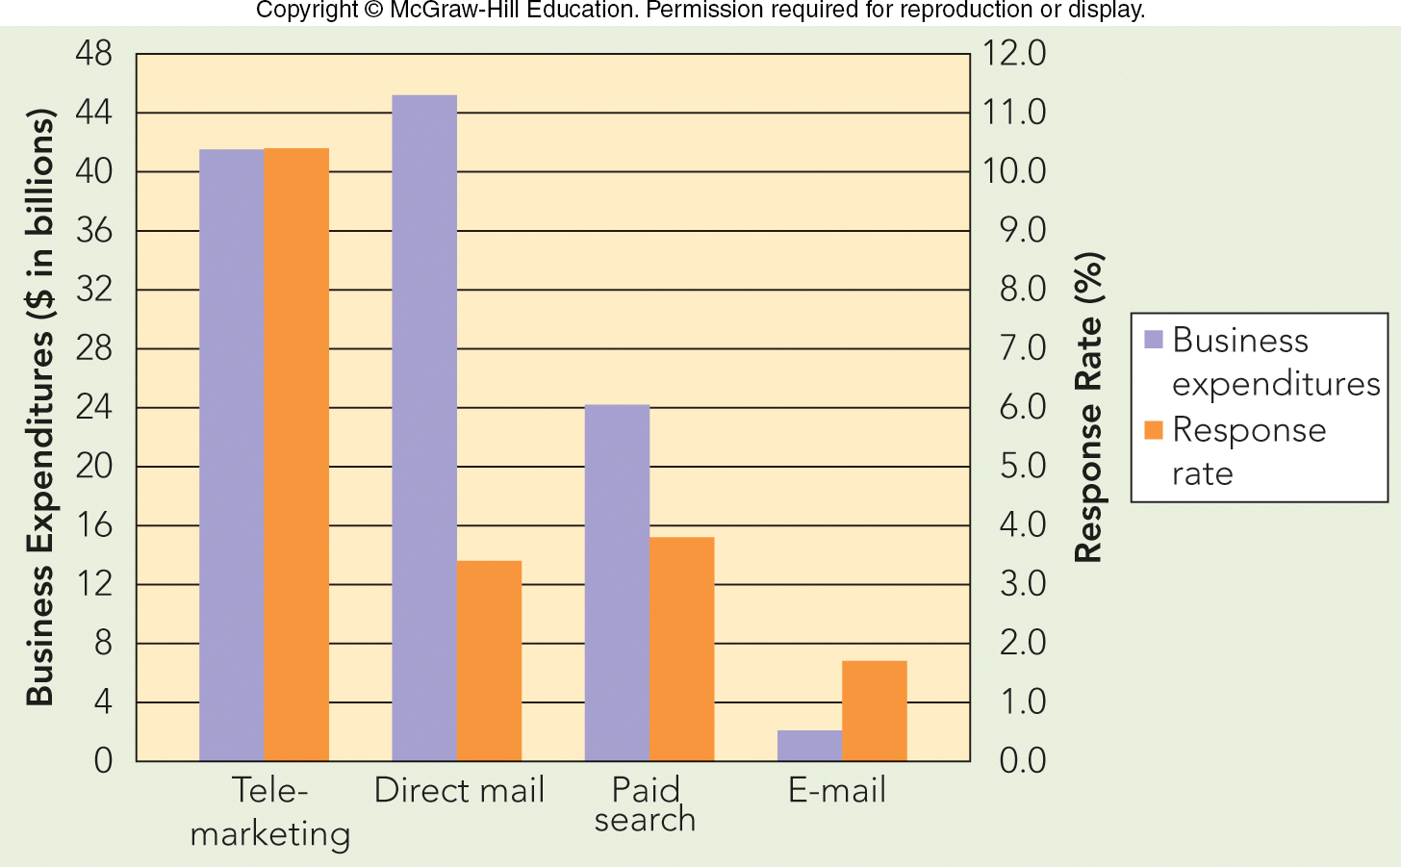
FIGURE 17-8 Business usage and response rates of popular forms of direct marketing

Slide 33
Wednesday homework……
Homework Assignment – Read Chapters 18,19
CAPE Evaluations please!! (2% points towards Final Exam grade)

Slide 34
The Rady School of Management
MGT 103
Lecture #14
Retailing & Wholesaling
Marketing Communications
March 2, 2020

